Slide 1
Call CENTRE ANALYTICS
Bank Of Baroda Hackathon
TEAM - Seal Team 6

Slide 2
01
02
03
Table of contents
04
05
06
07
Problem Overview
High Level Implementation
Model Architecture
Centralized Dashboard
Key Performance Indicators
Scalability and Future Scope
Plan of deployment of code

Slide 3
PRoblem STATEMENT
The problem being addressed is analysing various call recordings by converting speech to text and then performing sentiment analysis and estimating user satisfaction.
We chose this problem statement because of its wide application. With India being home to many regional and native languages, it is a major problem of understanding what the user speaks. By performing speech translation we can bridge the language gaps between customers and users.
Another reason for choosing this problem statement is looking at the business perspective. By performing sentiment analysis and analysing calls to estimate customer satisfaction, the companies will be able to make both qualitative and quantitative use of the data that is available to them.

Slide 4
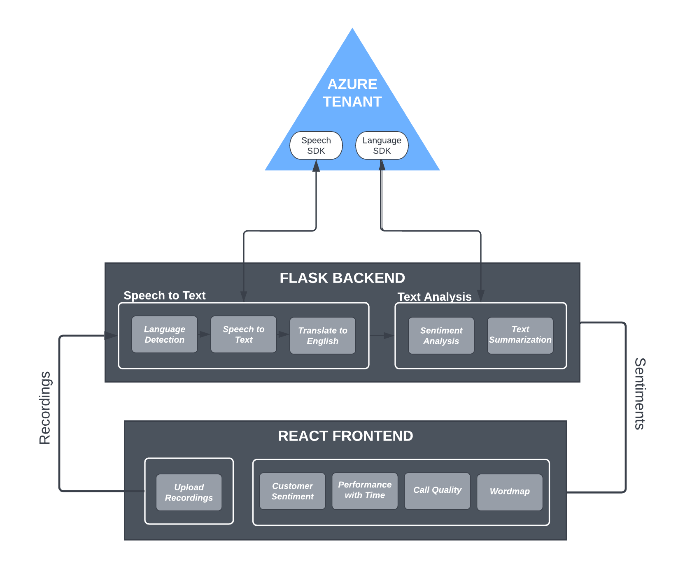
High level
implementation

Slide 5
Frontend
Backend
TECHSTACKS
React JS
Chart JS
FLASK
Azure Cognitive and Language services

Slide 6
1. Language identification
2. Speech Recognition
AZURE TOOLS AND RESOURCES
3. Speaker Diarization
4. Speech Translation
This library helps us to detect languages in the audio. As, our audio contains mixture of languages, We use Continuous LID provided by Azure to identify multiple languages for the duration of the audio.
We use speechsdk’s SpeechRecognizer after identifying the language in an audio source, to transcribe the audio/ speech to text.
We perform speaker diarization to identify the customer in the speaker to perform sentiment analysis on the sentences spoken by customers.
After recognizing the language in the audio and transcribing the audio to text, we then translate the entire call recording to a common language english using Azure’s TranslationRecognizer.

Slide 7
AZURE TOOLS AND RESOURCES
5. Sentiment Analysis
6. Text Summarization
7. Batch Transcription
Lastly, we use azure.ai.textanalytics to perform sentiment analysis and opinion mining to understand positive and negative sentiments of the speaker and calculate KPIs like customer satisfaction etc.
We use azure.ai.textanalytics to summarize the call recordings.
We use azure CreateTranscription and GetTranscription to store file urls in azure cloud and get transcribed results in batches fast and efficiently.

Slide 8
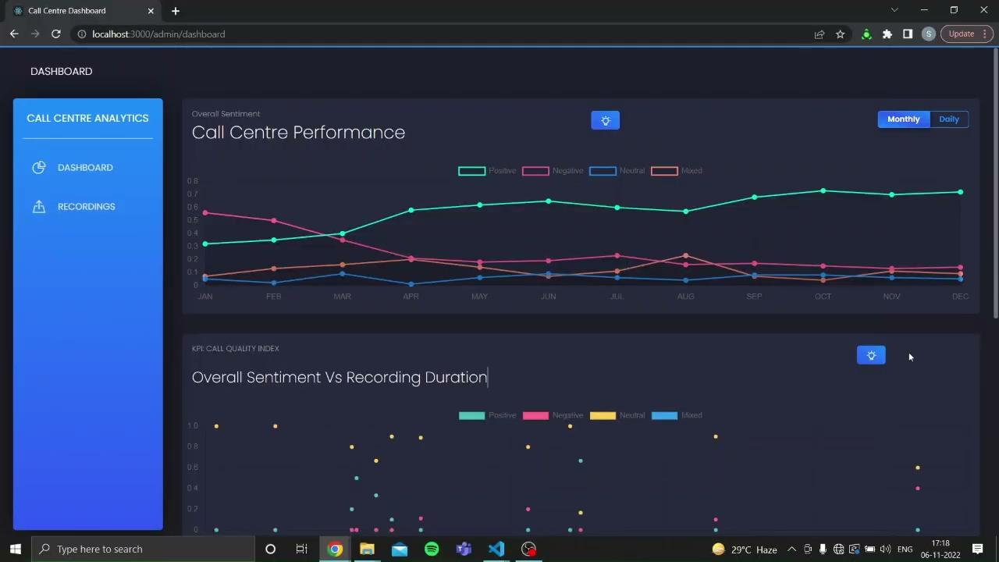
DEMO

Slide 9
KEY PERFORMANCE INDICATORS
OVERALL PERFORMANCE GRAPH
CALL QUALITY INDEX
Customer saTISFACTION INDEX
We show a scatter plot of overall sentiment and call duration. In general a call duration of less than 5 minutes is considered appropriate for a good call. So a call having a positive score of greater than 0.5 and recording duration less than 5 minutes is considered satisfactory.
Customer Satisfaction (CSAT) is a very commonly used CX metric to determine how satisfied customers are with your company's products or services. Here we have created a pi chart showing the overall sentiment of all the recordings. It shows the overall positive, negative, neutral and mixed score of the recordings.
The Overall Performance Graph shows the evolution of the overall sentiments of all the calls with time. It is a measure of the overall performance of the call centre.

Slide 10
scalability
Azure batch TRANSCRIPTION
Flask and sqlalchemy
CEntralized backend
Allows large amount of audio to be transcribed by azure resources using concurrent processing. Results can then be fetched asynchronously
Using flask as backend with SQLAlchemy allows easy connections to any major DBMS such as PostGres, MySQL, etc.
Allows access to resources from multiple locations with ease and can serve multiple users with ease.

Slide 11
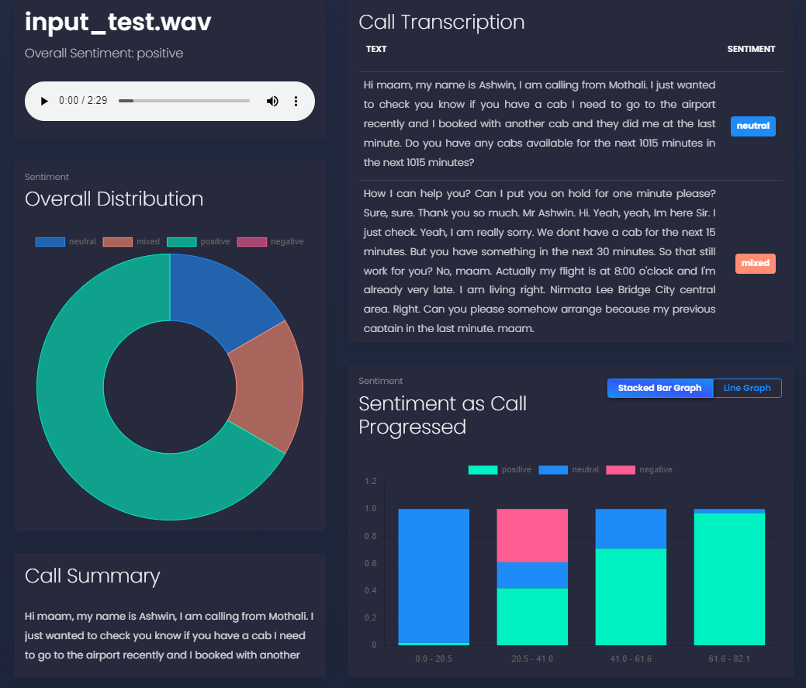
INPUT TEST CASE 1

Slide 12
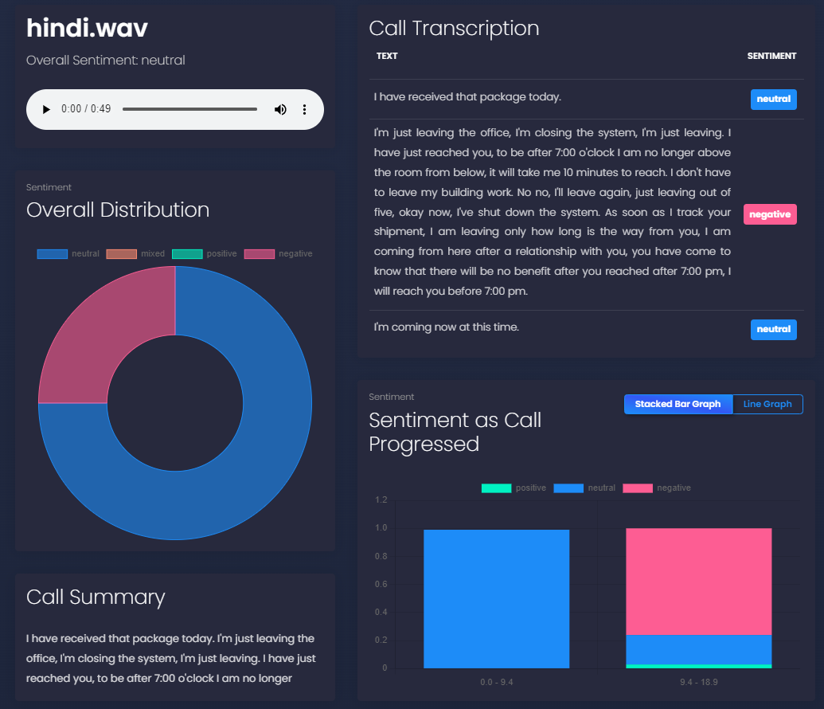
INPUT TEST CASE 2 - hINDI + eNGLISH RECORDINGS

Slide 13
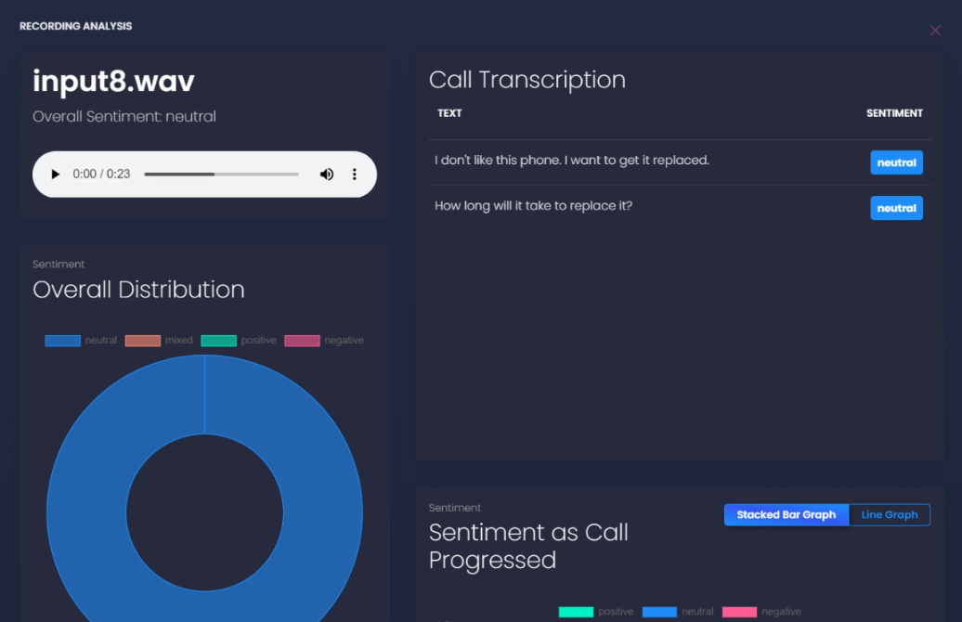
INPUT TEST CASE 3 - MARATHI + eNGLISH RECORDINGS

Slide 14

Plan Of Deployment
Prerequisites from bank
Infrastructure
High Level KPIs
A server and a GPU (for tasks like speaker diarization)
Tentative setup duration - 1 week
Customer Satisfaction (CSAT)
Call Quality Index
Call Sentiment
Call Hygiene
Server
Standard Azure Subscription
Call Recordings Dataset

Slide 15



MEET THE TEAM
Shirin Jain IIT Guwahati
Shiv Chauhan IIT Guwahati
Snigdha Jain IIT Guwahati

Slide 16
Thank You

